Slide 1
Artificial intelligence – Sem 4
Topic - Artificial Intelligence History
Presented by -Tejas dhanariya

Slide 2
1940-1960: Birth of AI in the wake of cybernetics
The period between 1940 and 1960 was strongly marked by the conjunction of technological developments (of which the Second World War was an accelerator) and the desire to understand how to bring together the functioning of machines and organic beings. For Norbert Wiener, a pioneer in cybernetics, the aim was to unify mathematical theory, electronics and automation as "a whole theory of control and communication, both in animals and machines". Just before, a first mathematical and computer model of the biological neuron (formal neuron) had been developed by Warren McCulloch and Walter Pitts as early as 1943.
The term "AI" could be attributed to John McCarthy of MIT (Massachusetts Institute of Technology), which Marvin Minsky (Carnegie-Mellon University) defines as "the construction of computer programs that engage in tasks that are currently more satisfactorily performed by human beings because they require high-level mental processes such as: perceptual learning, memory organization and critical reasoning. The summer 1956 conference at Dartmouth College (funded by the Rockefeller Institute) is considered the founder of the discipline

Slide 3
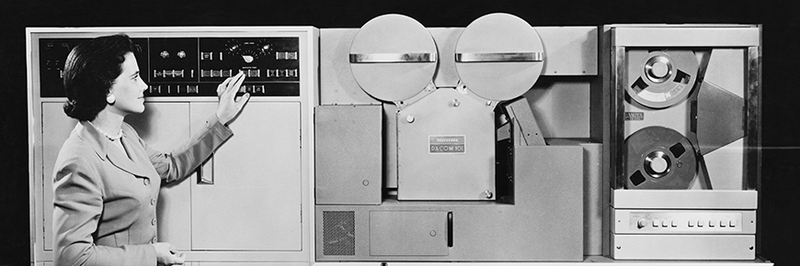
Since 2010: a new bloom based on massive data and new computing power
access to massive volumes of data. To be able to use algorithms for image classification and cat recognition, for example, it was previously necessary to carry out sampling yourself. Today, a simple search on Google can find millions.

Slide 4
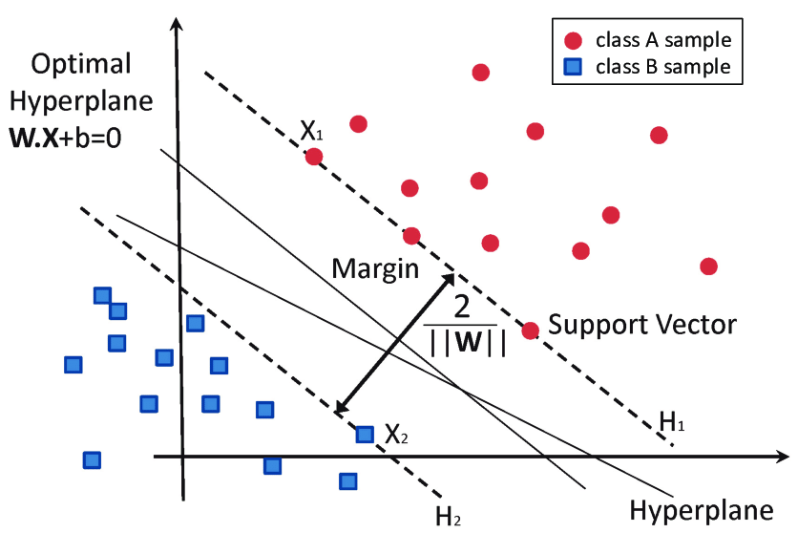
Artificial Intelligence Techniques
Support Vector Machines
the objective is to determine whether a given data point belongs to a certain class or not. After first training a classifier model on data points for which the class is known (e.g. a set of emails that are labeled as spam or not spam), you can then use the model to determine the class of new, unseen data-points. A powerful technique for these types of problems is Support Vector Machines
The main idea behind SVM is that you try to find the boundary line that separates the two classes, but in such a way that the boundary line creates a maximum separation between the classes. To demonstrate this, we will use the following simple data for our classification problem:

Slide 5
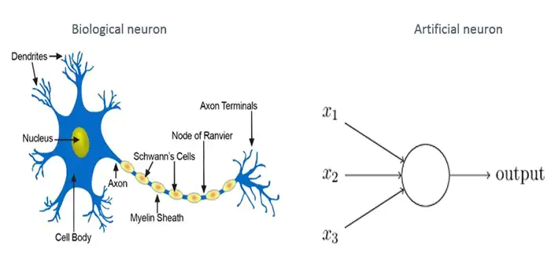
2.Artificial Neural Networks
Animals are able to process (visual or other) information from their environment and adapt to change. They use their nervous system to perform such behavior. Their nervous system can be modeled and simulated and it should be possible to (re)produce similar behavior in artificial systems. Artificial Neural Networks (ANN) can be described as processing devices that are loosely modeled after the neural structure of a brain. The biggest difference between the two is that the ANN might have hundreds or thousands of neurons, whereas the neural structure of an animal or human brain has billions.
While learning consists of strengthening or weakening the bonds between different neurons in the biological brain, in the ANN learning consists of changing the weights between the neurons. By providing the neural network with a large set of training data with known features, the best weights between the artificial neurons (i.e. strength of the bond) can be calculated in order to make sure that the neural network best recognizes the features.

Slide 6
Thank you

